Slide 1

Online Doctor Appointment System
Presented By
Shubham Sawarkar & Kalyani Sawant

Slide 2
Introduction
The Main purpose of developing the “Online Doctor Appointment System” is to provide appointment booking facility for hospital from anywhere. This system help reduce the problems occur when using the manual system and helps patients to skip endless queues.
The important thing is it will become easier for the data record and retrieval. This software also stores all the patient details, patients profile, prescriptions etc. This system enables doctors and clinic assistant to manage patient records and appointments. User can enter their details, update their profile and they can select doctors to make appointments.

Slide 3
Technology Used
We used Java Spring-Boot as backend and React JS as Frontend in our Project.
Spring-Boot :–
The main goal of the Spring Boot framework is to reduce overall development time and increase efficiency. Spring boot is better suited for building REST APIs because: It has an embedded Tomcat server to run applications. It doesn't require complex XML configurations. It includes an auto-configuration feature that configures an application for certain dependencies automatically.
React :–
React allows developers to create large web applications that can change data, without reloading the page. The main purpose of React is to be fast, scalable, and simple. Spring

Slide 4


User Classes
User
Doctor
In this module User will register, update details or and can apply for the appointment. Also can view appointment details
Doctors can edit their profile and view their upcoming appointments, patients etc. They can even send prescriptions to their patients by selecting their patients from the dropdown list

Slide 5
Product Functions
Users can view available doctors and their timings and can make appointments according to it.
Users also get an option to cancel their appointments.
Users can view their upcoming appointments and past appointments are deleted automatically.
Doctors can edit their profile and view their upcoming appointments, patients etc.

Slide 6
Product Functions
Manual work which is time consuming can be reduced.
Easy to store data in the database.
Administrator can add/remove new doctors, patients & departments.
Increase processing speed.
An easily access environment for users.
Doctors can view/cancel appointments.
removal of past appointments.
Easy to use real time search facility.
Responsive layout that fits all devices.
Improved security

Slide 7
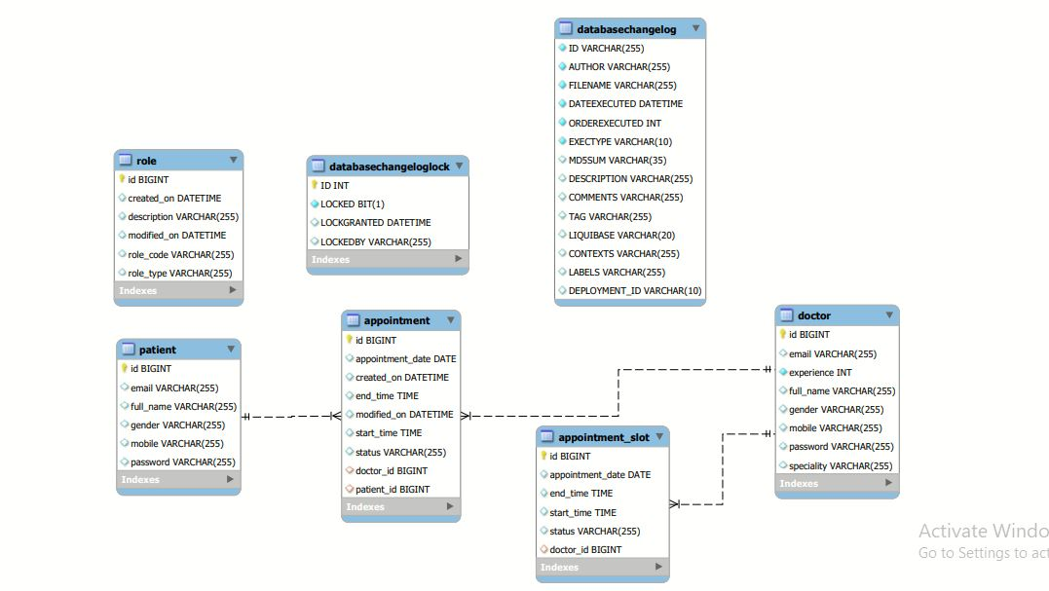
EER Diagram

Slide 8
User Module
User Registration
Registering the user by the details that includes Name, Username, Email Address , Password, Residential Address, Phone Number, Gender etc.
Profile
Users can edit and update their profile including their password.
Doctors List
Users can browse through the entire list of doctors and select one for making appointment.
Upcoming Appointments
User can view/delete upcoming appointments. Past appointments are automatically removed from the list to show only the relevant contents

Slide 9
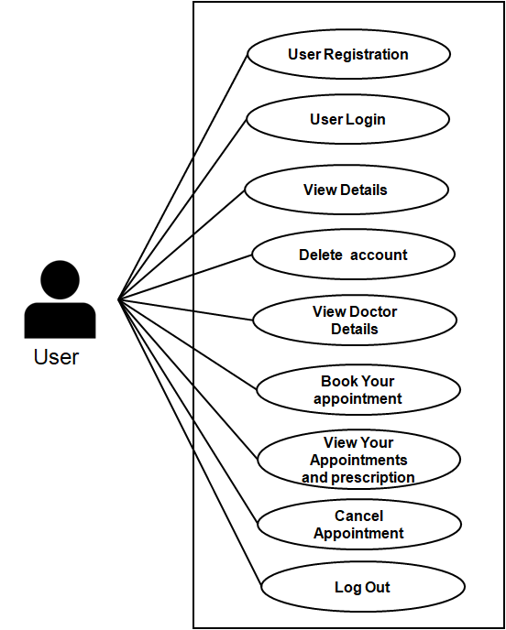
Use Case diagram for User

Slide 10
Doctor Module
Doctor Profile
Doctors can edit their profile details such as Name, Qualification etc.
Upcoming Appointments
Doctors can view their upcoming appointments here. They can change appointment status to Pending or Active. They can even cancel the appointment. Also can add prescription.

Slide 11
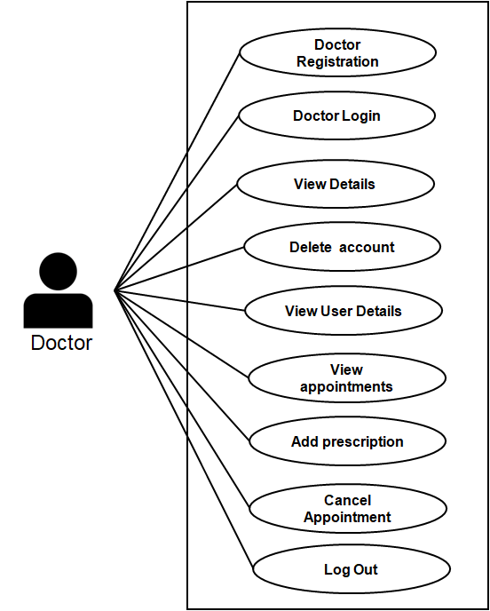
Use Case diagram for Doctor

Slide 12
Activity Diagram : Doctor
Doctor Registration
Start
Doctor Login Credentials
Invalid Credentials
Doctor Login Successful
Your Appointments
Dashboard
End

Slide 13
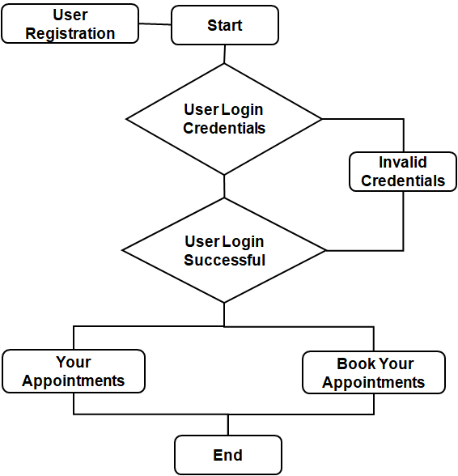
Activity Diagram : User

Slide 14
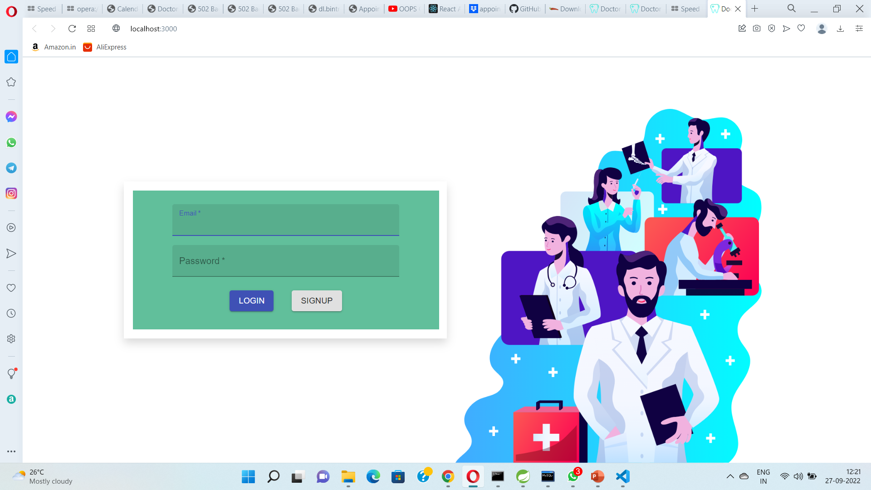

Slide 15
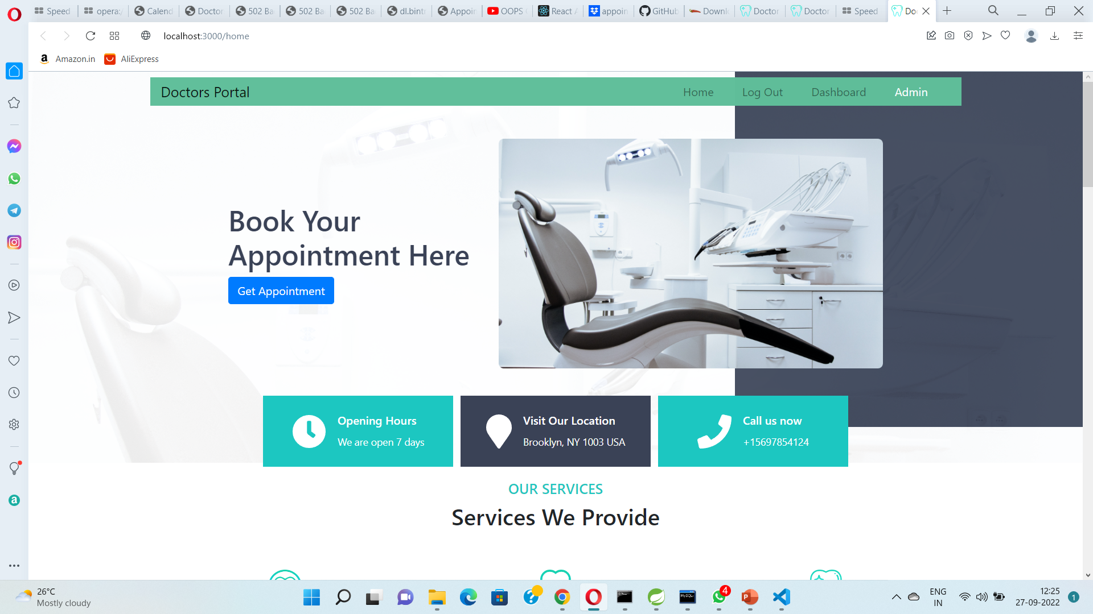

Slide 16
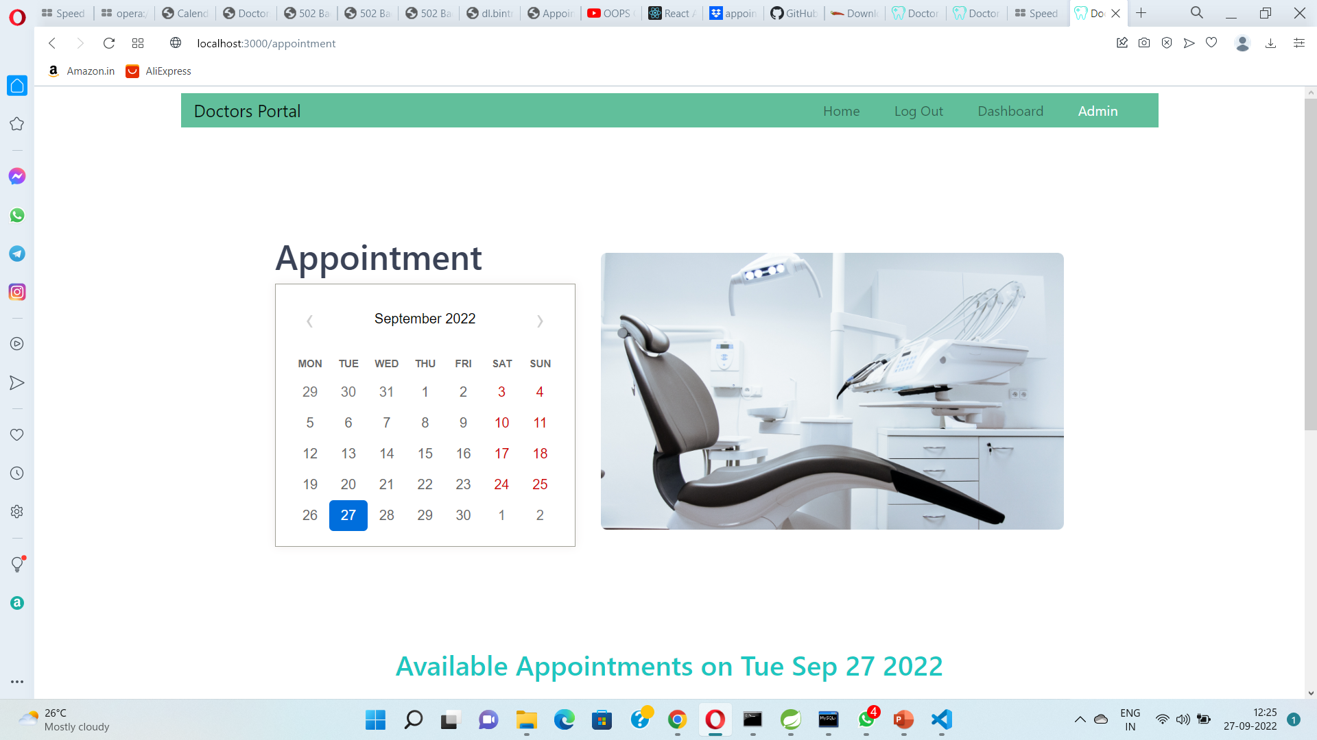

Slide 17
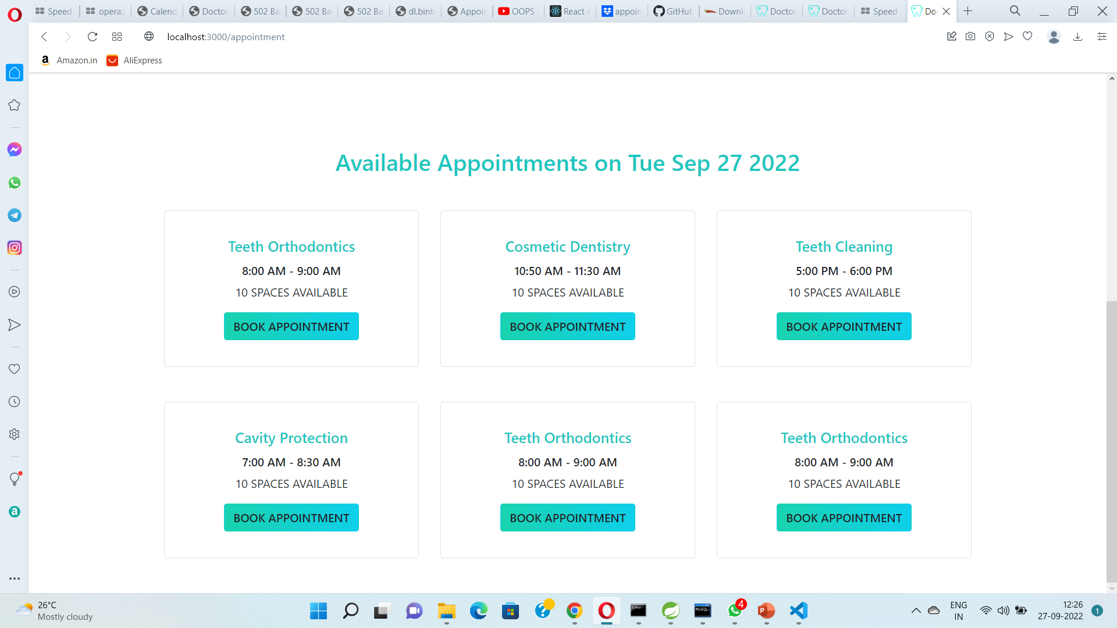

Slide 18
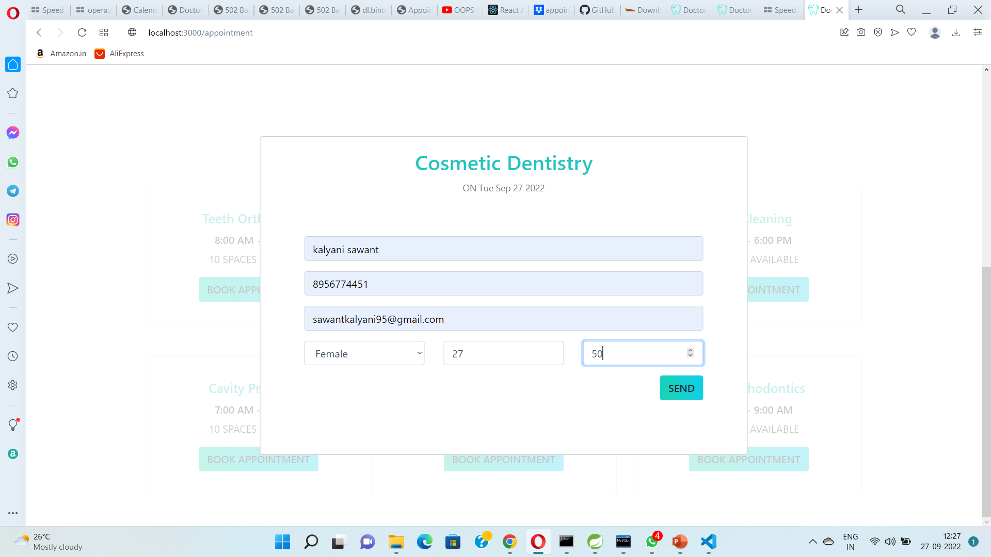

Slide 19
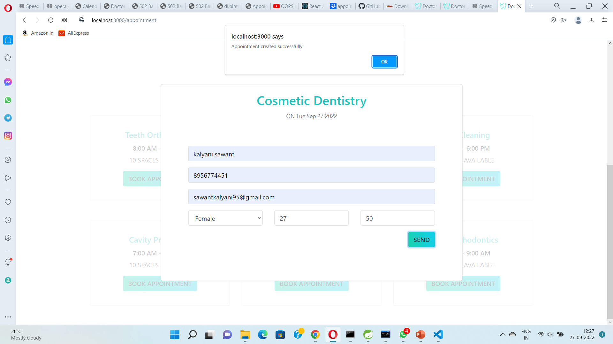

Slide 20
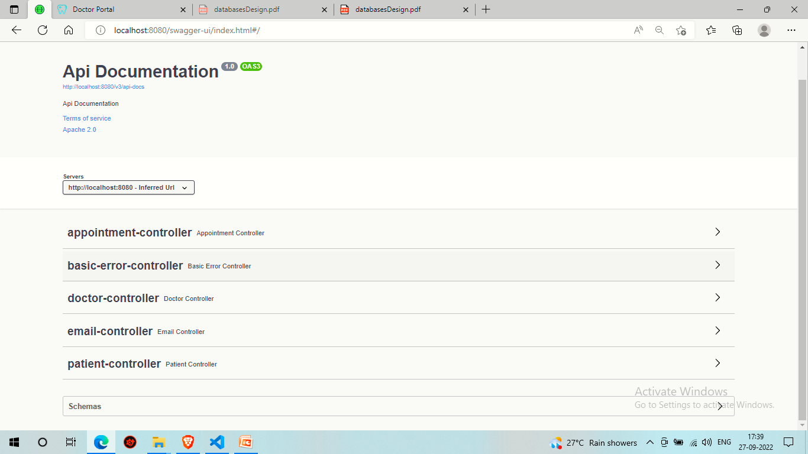

Slide 21
Thank You !

Slide 22

User Registration
Start
User Registration
User Login Credentials
User Login
View Details
Invalid Credentials
User Login Successful
Delete account
View Doctor Details
User
Book Your appointment
Your Appointments
Book Your Appointments
View Your Appointments and prescription
End
Cancel Appointment
Log Out

Slide 23
Doctor Registration
Start
Doctor Registration
Doctor Login Credentials
Doctor Login
View Details
Invalid Credentials
Doctor Login Successful
Delete account
View User Details
Doctor
View appointments
Your Appointments
Dashboard
Add prescription
End
Cancel Appointment
Log Out

